Slide 1

Memory Management System Project Elaboration 2
By: Mai Lor, Thanh Tran, and Greg Payne

Slide 2
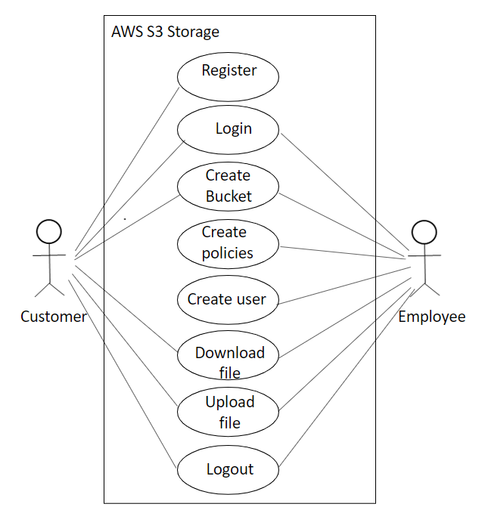
USE CASE
Diagram

Slide 3
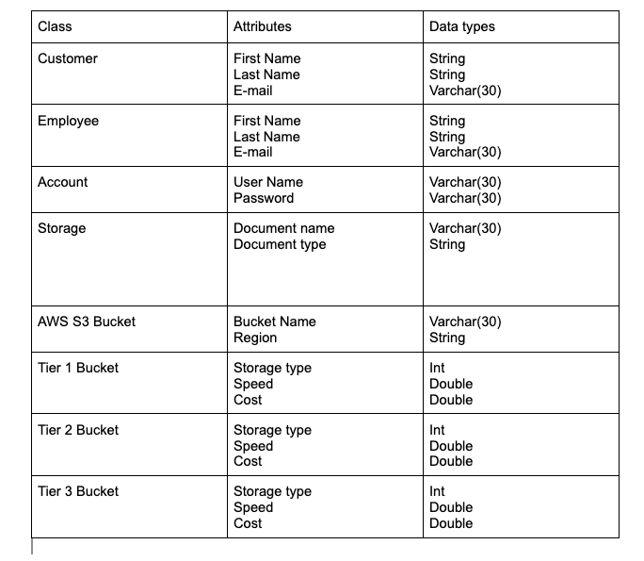
Updated Data Model

Slide 4
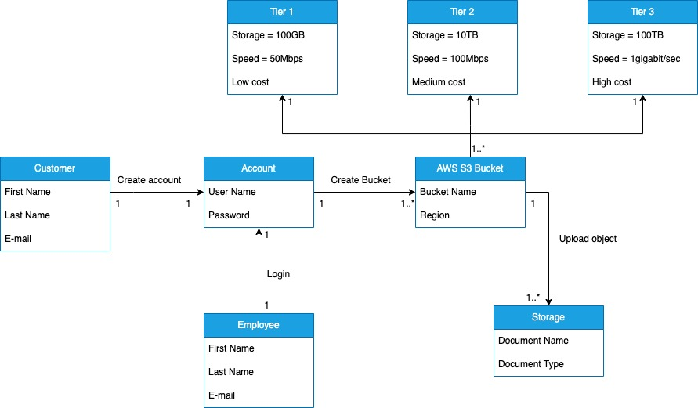
Updated Domain Model

Slide 5
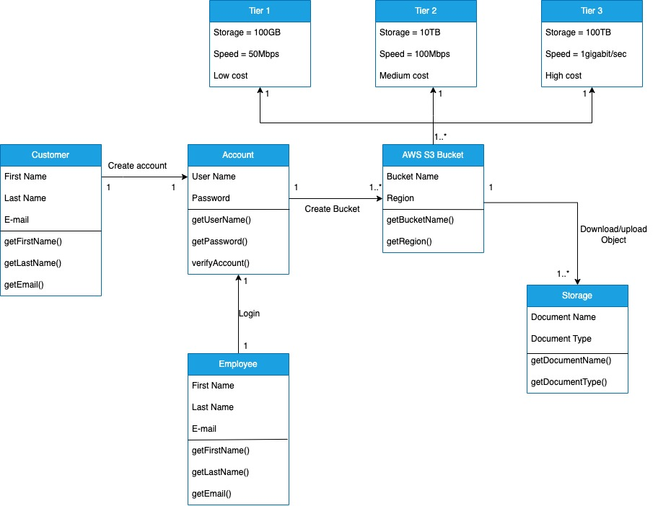
Updated Class Model

Slide 6
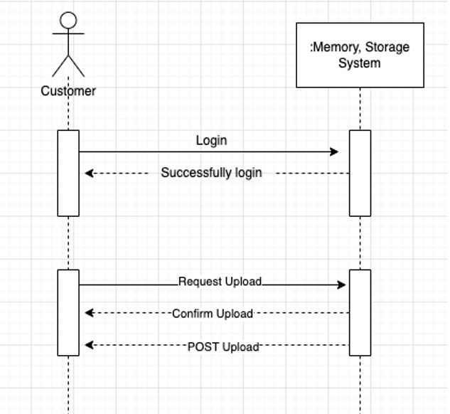
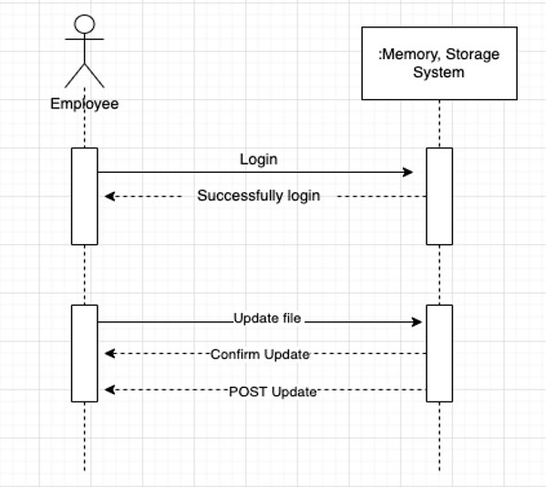
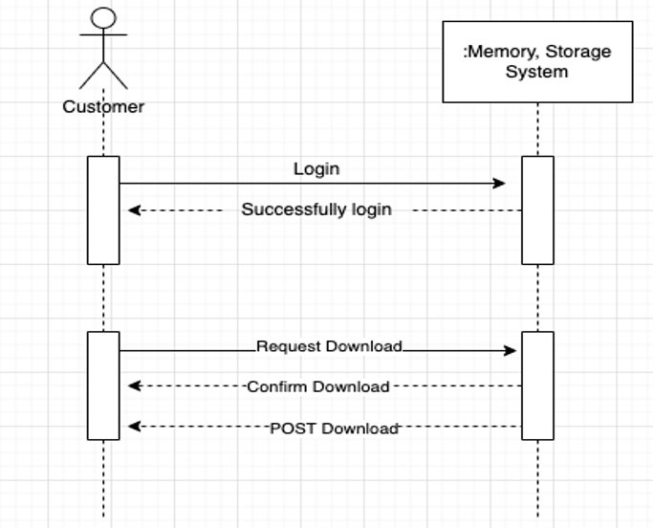
Updated SSD
Customer uploads object
Customer download object
Customer updates object

Slide 7
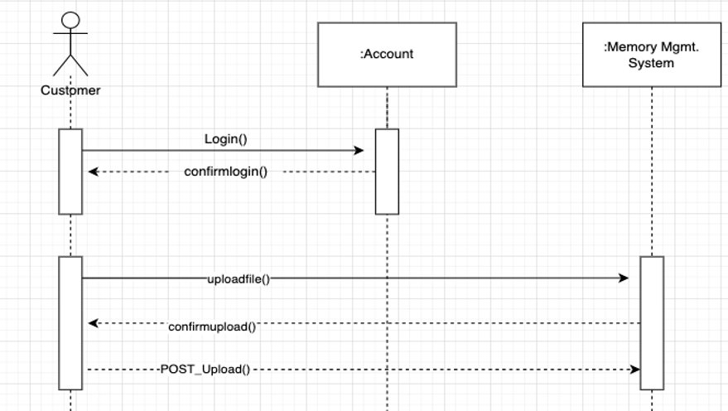
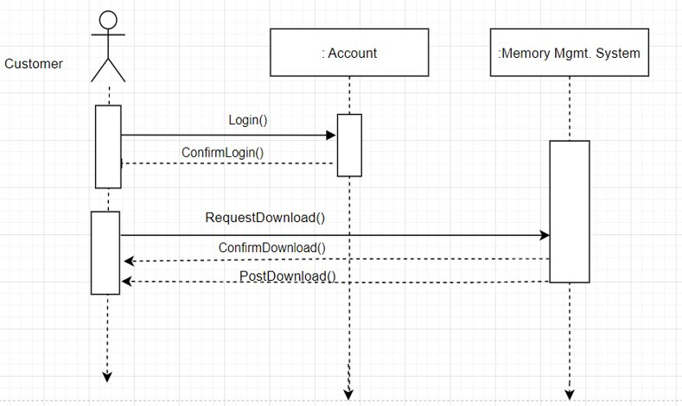
Updated SSD

Slide 8
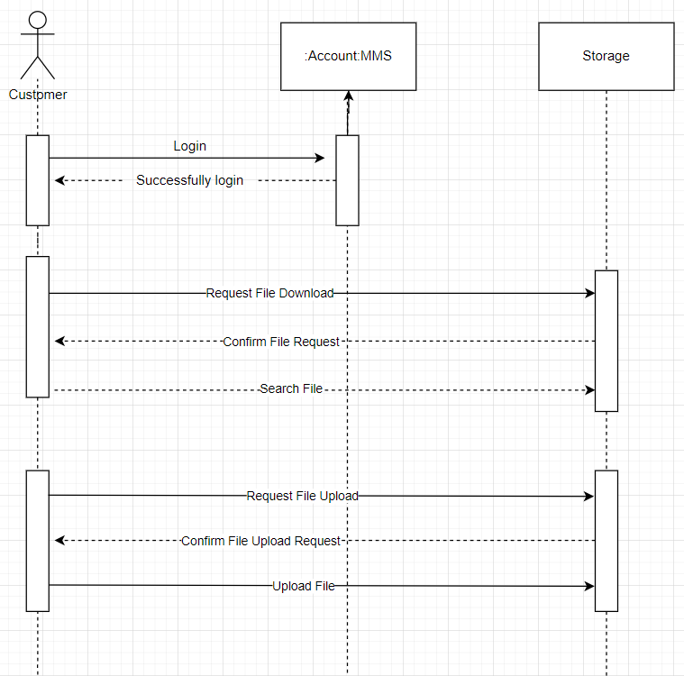
Updated memory Storage System Model: Sequence Diagram

Slide 9
Updated Domain Model With Grasp Patterns
Customer is the Creator of Account.
Account fills the Role of Controller, controlling the behavior of the AWS S3 Bucket and relaying requests.
AWS S3 Bucket serves as an Adapter between for Storage.
AWS S3 Bucket serves as a Factory for new Tier I, II, and III Buckets.
Like most Factory classes, AWS S3 also serves as a Singleton for the MMS.

Slide 10
GRASP Pattern: Creator
The Customer class creates instances of Account and its subclasses, Basic, Plus, and Deluxe, filling the Creator role. Customer's singular role in our domain model is to create the Account and specify account details. Once created, the account becomes the Memory Management's major Actor.

Slide 11
GRASP Pattern: Controller
Once an account is initialized by one of our Customers in the Memory Management System, the Account assumes the role of Controller by managing system requests to and from the S3 Bucket.
The Account is a non-user object that receives and sends requests for data between the user and S3 Buckets, which store large amounts of data.

Slide 12
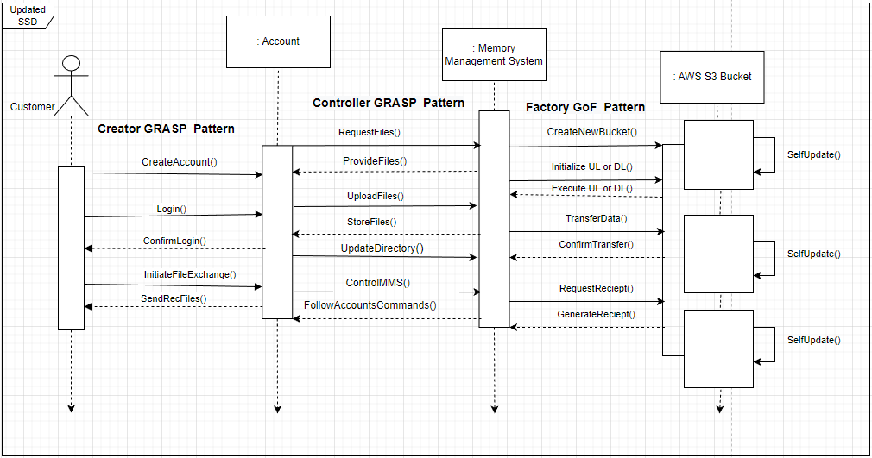
Creator, Controller, and Factory Updated SSD with GRASP and GoF Patterns
Customer acts as the Creator for Account, while Account acts as the Controller for the Memory Management System.
The MMS acts as a factory for new AWS S3 Buckets.

Slide 13
GRASP Pattern: Polymorphism & GoF Pattern: Adapter
The Polymorphism GRASP pattern applies to our three subclasses Basic, Plus, and Deluxe extending the superclass Account. These subclasses share the basic blueprint for Account, but each varies in memory storage size and cost to the customer.
This relationship also represents the Adapter pattern. Whenever a variation of an account is needed, the subclasses serve as Adapters.

Slide 14
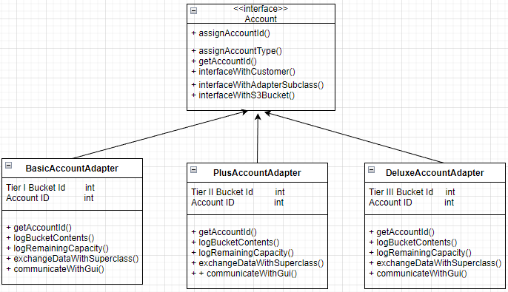
GRASP Patterns: Polymorphism & Adapter Class Diagram
Using the Polymorphism GRASP pattern, the Account type adapters for Plus, Basic, and Deluxe inherit Account's blueprint, but have their own variations in storage capacity and data transfer speed.

Slide 15
GoF Pattern: Factory
The S3 Bucket class models the GoF pattern known as Factory. That means it creates instances of classes In response to requests it receives from the account class, it manufactures individual bucket objects without exposing creation logic to the client.
Depending on requests made by an Account object, the S3 Bucket class can create three distinct object types: Tier I Bucket, Tier II Bucket, Tier III Bucket.

Slide 16
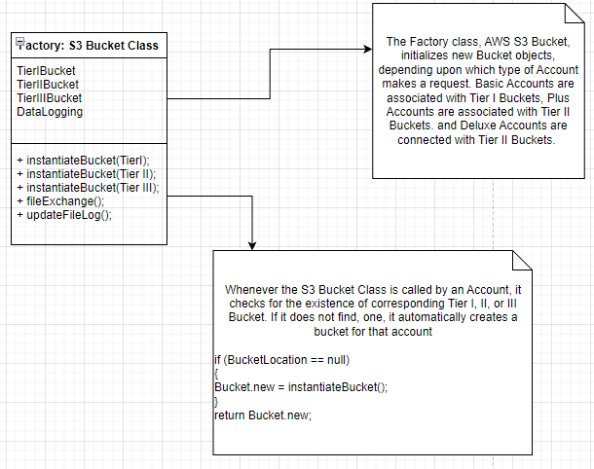
GoF Pattern: Factory

Slide 17
GoF Pattern: Singleton
Our S3 bucket system represents the GoF pattern for Singleton. The Memory Management System will always employ a single instance of the S3 Bucket System, which communicates with all of our buckets and accounts.

Slide 18
GoF Pattern: Façade
From the Customer's standpoint, the Account represents the entire Memory Management System, making the Account and our forward-facing GUI a Façade for the entire Memory Management System.

Slide 19
GoF Pattern: Observer
Each instance of Account keeps a virtual log of the contents of its corresponding Bucket so that it can show users which files are available to retrieve and manipulate.
Whenever an Account initiates a change in the contents of its corresponding Bucket, the AWS S3 Bucket publishes an content update to Account.
Account maintains a log of the Bucket's contents based on changes it observes that are published by the S3 Bucket System.

Slide 20
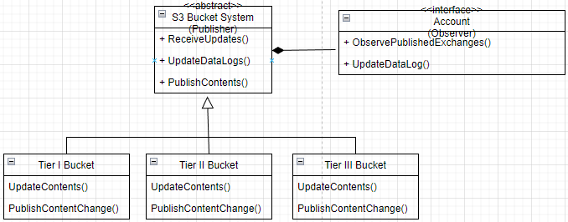
GoF Pattern: Observer Class Diagram
Account objects observe updates published by the S3 Bucket System.
The S3 Bucket System observes content updates from each of the three bucket types.
Account updates its log of contents for the appropriate bucket.

Slide 21
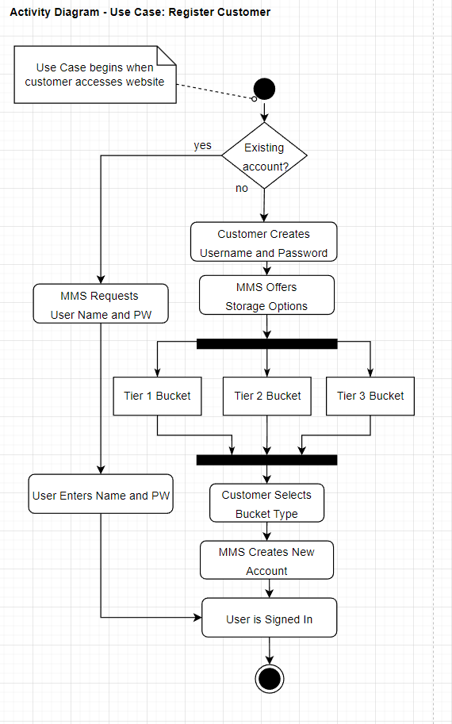
Activity Diagram Use Case: Register Customer

Slide 22
Activity Diagram​ ​ Use Case: Register
Customer
In the Activity Diagram above, see how a user creates a new account with the Memory Management System
First MMS checks to see if an account exists if it does it prompts the user for a name and password. The system prompt the user to create a new password and select one of three storage options ranging from tier I to tier III.
Once a tier is selected, the MMS automatically creates a corresponding bucket object and account, then links these two with the user's name and password.

Slide 23
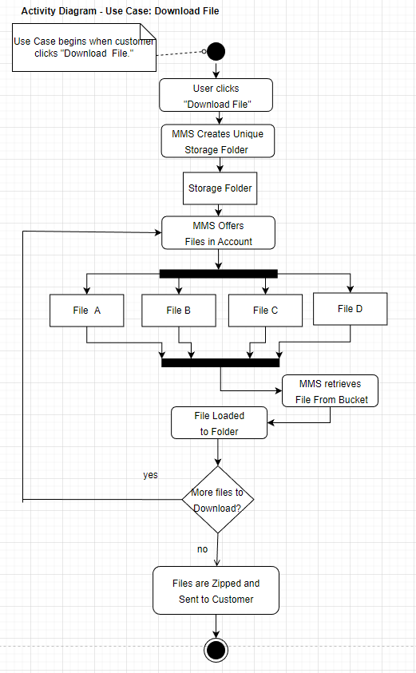
Activity Diagram Use Case: Download File

Slide 24
Activity Diagram Use Case: Download File
The above activity diagram shows MMS's behavior for the use case "Download File."
When the customer initiates a file download, MMS immediately creates a unique storage folder object that will hold the data in zipped format.
Next, the MMS offers a list of the user's files. Selected files are loaded into the zip folder. When the user has completed the file selection process, the MMS retrieves the chosen files from the storage bucket, and zips them into a folder that is then sent to the user.

Slide 25
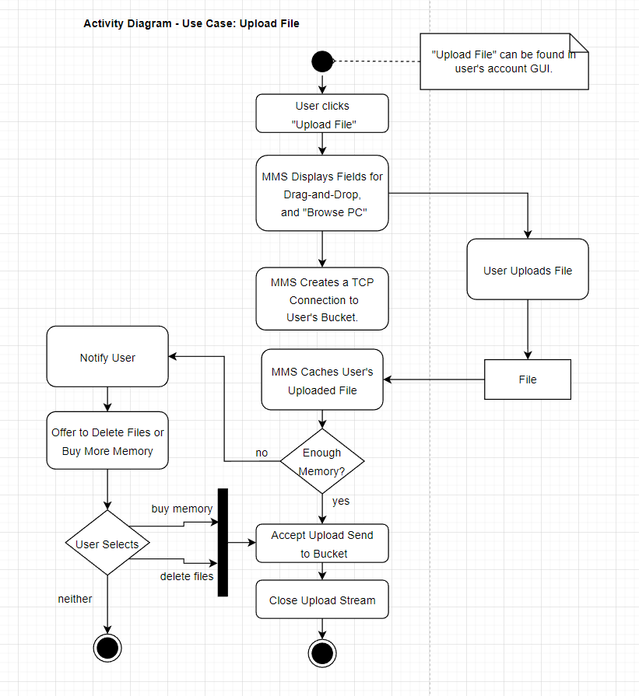
Activity Diagram Use Case: Upload File

Slide 26
Activity Diagram Use Case: Upload File
The above activity diagram shows MMS's behavior for the use case "Upload File."
When the customer initiates a file upload, the MMS immediately displays a file upload field with the option to either drag and drop or to browse the user's pc. It then locates and opens a secure TCP connection to the user's unique storage bucket.
MMS accepts the user's file selection and evaluates the file size against the user's available storage space.
If the user has enough space, the file is transferred to their bucket. If not, the user is prompted to delete files, purchase more space, or cancel the transaction.

Slide 27
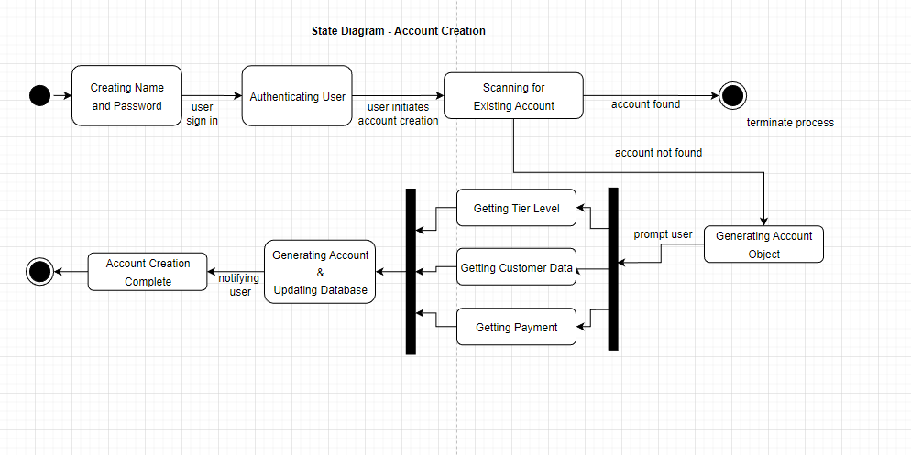
State Diagram: Account Creation

Slide 28
State Diagram: Account Creation
The above state diagram shows MMS's behavior for the account creation process.
Once a user creates their name and password, the Memory Management System offers them the chance to create a paid storage account.
When the user initiates account creation, the MMS automatically scans for an existing account with the user's identifying information. If it doesn't find one, the MMS presents fields for the user to provide more info.
When the user's info is submitted, three smaller menus appear in order, asking the user for their desired tier level, their payment information, and additional contact information and preferences.
The final step is to load the Account object with the data provided and update the MMS database accordingly.

Slide 29
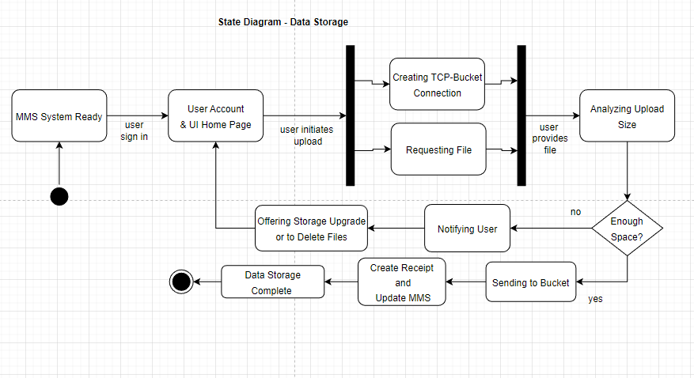
State Diagram: Data Storage

Slide 30
State Diagram : Data Storage
The above state diagram shows MMS's process for storing new data. This process is initiated by the user from his unique Account homepage.
Once the user initiates an upload, the MMS simultaneously creates a connection to the user's individual storage container and prompts the user to upload one or more files.
Once the MMS receives a file, it decides if the user has purchased enough storage space. If yes, the file is sent to storage, and the transaction is recorded. If no, the user is notified and given the choice of creating more space or cancelling the upload request.

Slide 31
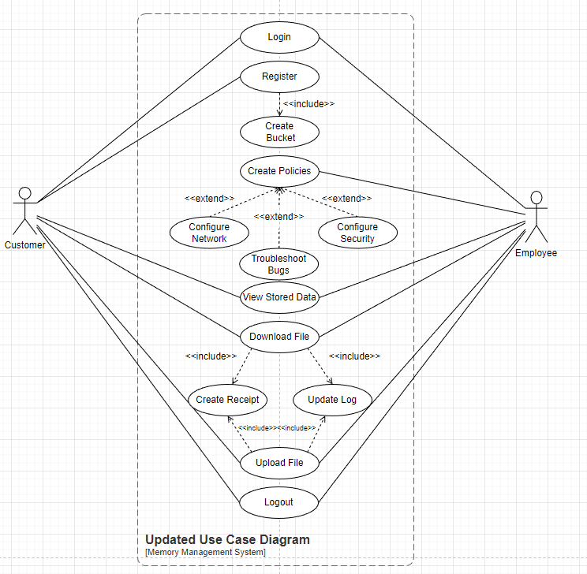
Updated Use Case Diagram With Include and Extend

Slide 32
Updated Use Case Diagram With Include and Extend
<Explanation>
We have updated our original use case diagram to include "include" and "extend" relationships between several of our use cases.
The original structure stays the same, giving the user a linear sequence through registering an account creation and uploading and downloading files.
Registering an account is now always accompanied by creating a storage bucket object via an include relationship.

Slide 33
Updated Use Case Diagram With Include and Extend
<Explanation>
The Employees' Create Policies use case now has three extension relationships branching out, granting the additional system administration duties of Configuring the Network, Troubleshooting Bugs, and Configuring Security.
The final update that we've added to Elaboration 3 is that both use cases: Download File and Upload File include creating transactional receipts an updating the log of files held by the Memory Management System.

Slide 34
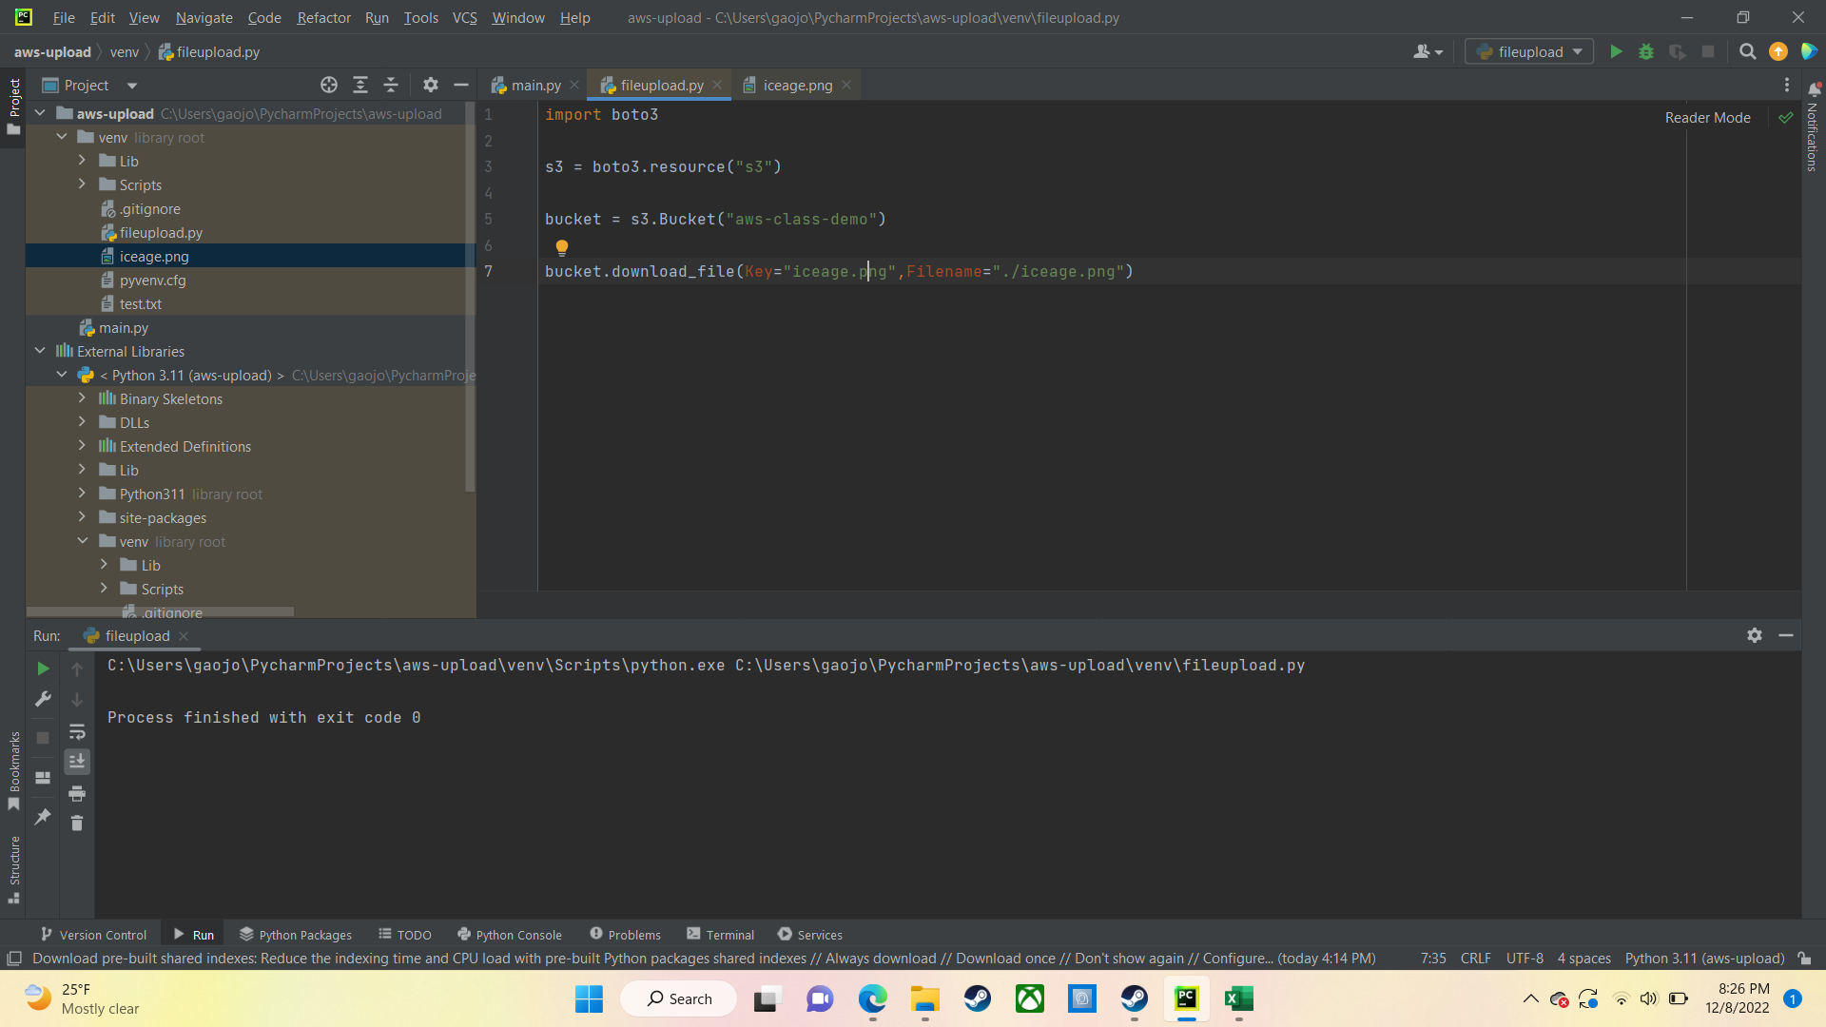
Demo
Downloading object use case

